Slide 1

Baseball Advanced Statistical Analysis (2021)
By: Thomas Greve and Ryan Johnson
Notes:
Tommy

Slide 2
Overarching Questions
How accurately do Statcast metrics predict actual performance?
What is Statcast?
State of the art tracking technology to measure new aspects of baseball
Uses high-resolution cameras to measure movement and location
Use this to develop predictive metrics
Where can Statcast metrics be found?
All of our data was found on BaseballSavant.com
Notes:
Tommy

Slide 3
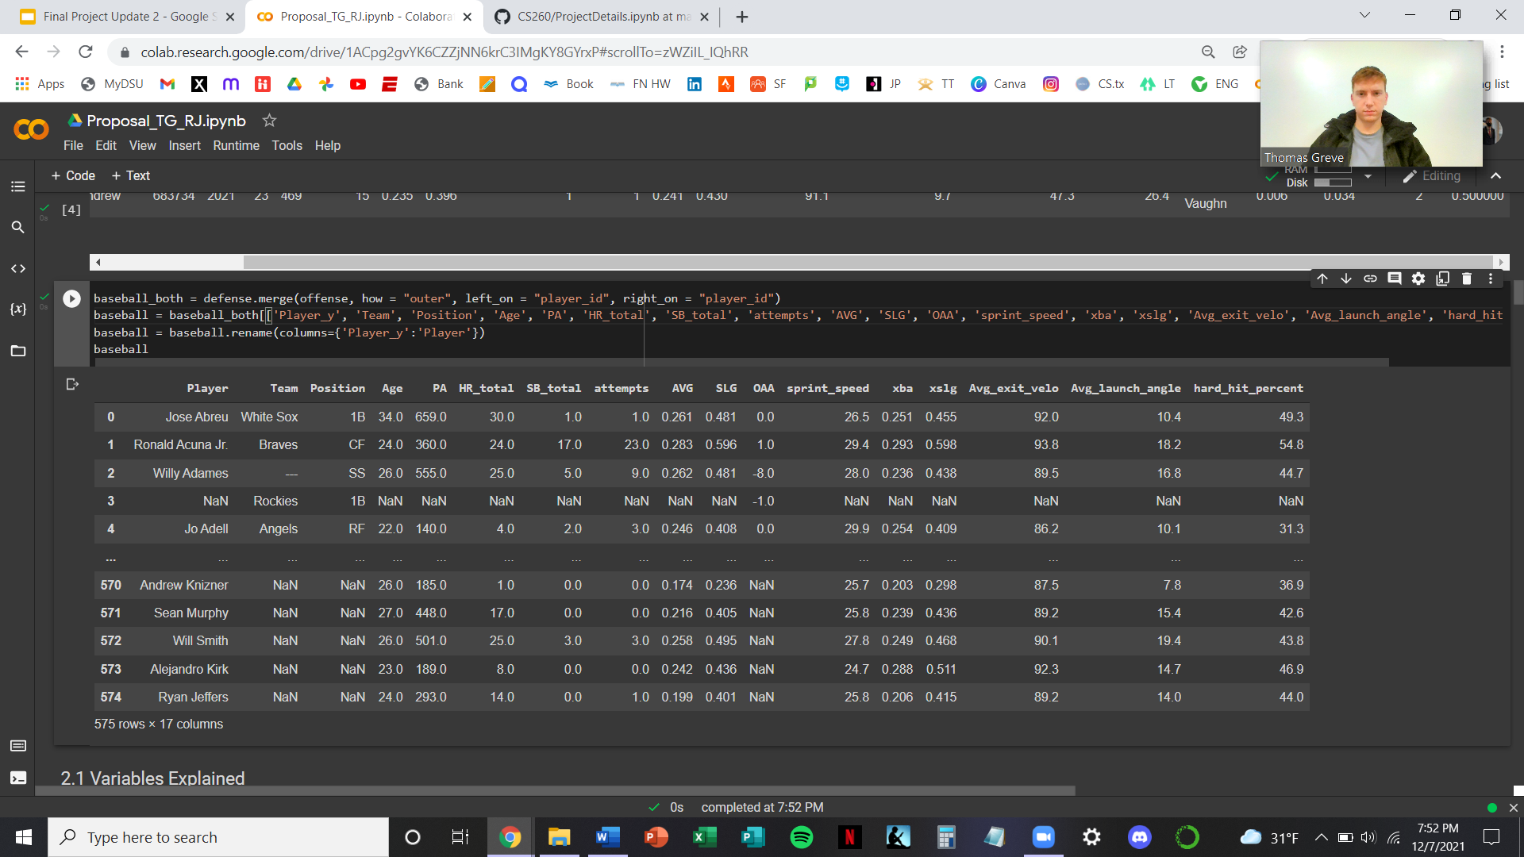
Traditional Variables and Statistics
Notes:
Tommy

Slide 4
Statcast Specific Statistics
Notes:
Ryan
Sprint_speed: in feet per second, the average speed of a player on the basepath
Avg_exit_velo: the average velocity of the ball off of the bat for each batted ball event, excluding foul balls
Avg_launch_angle: the average angle of the ball hit off of the bat for each batted ball even, excluding foul balls
Expected_avg: measures the likelihood that a batted ball will become a hit
Expected_slugging: likelihood of an extra-base hit formulated using exit velocity, launch angle and, on certain types of batted balls and sprint speed
Hard_hit_percent: hard hit percentage is the percent of batted balls with an exit velocity of 95 mph or greater

Slide 5
Outs Above Average
Defensive Statistic
Shows the number of outs a player recorded over the average player
Formulate Catch/Out Probability
Outfield
The time the fielder has to get to the ball
The distance traveled
The direction traveled
Infield
Distance needed to travel to the ball
How much time he has to get there
How far he is from the base the runner is running to
And the average sprint speed of the runner
Notes:
Ryan

Slide 6
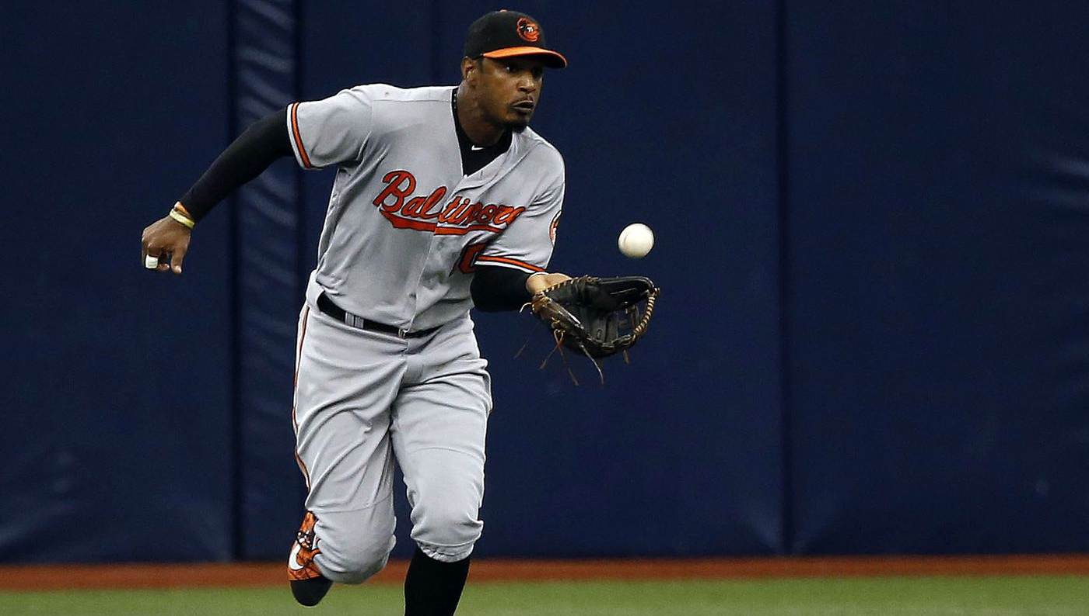
OAA Examples
Outfield video example:
Adam Jones (CF):
https://www.mlb.com/video/statcast-jones-blows-99-catch-c1830396483
Notes:
Ryan

Slide 7
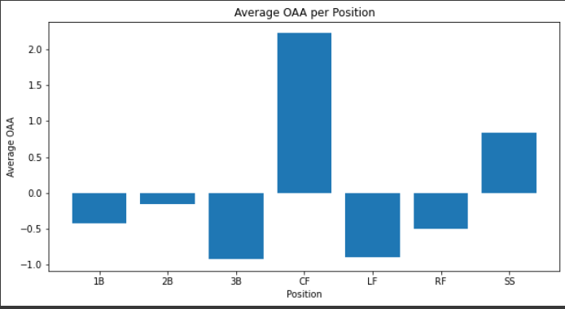
Do Outfielders Have a Higher OAA than Infielders?
Notes:
Ryan
Typically shortstops and centerfielders are seen as the stronger defenders

Slide 8
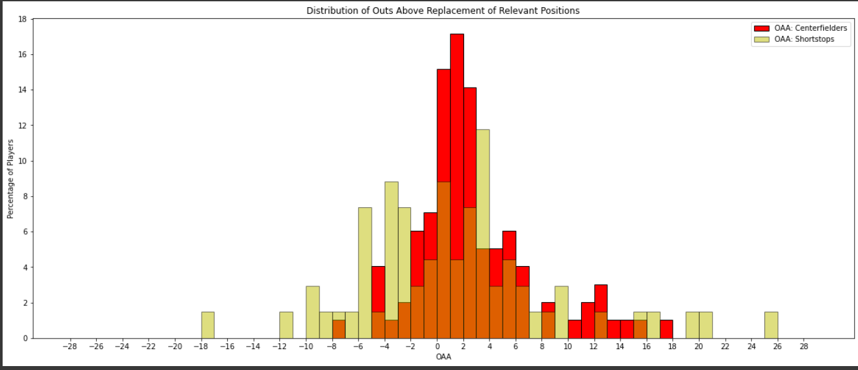
What About the OAA Between Just SS and CF?
Notes:
Tommy
Typically shortstops and centerfielders are seen as the stronger defenders

Slide 9
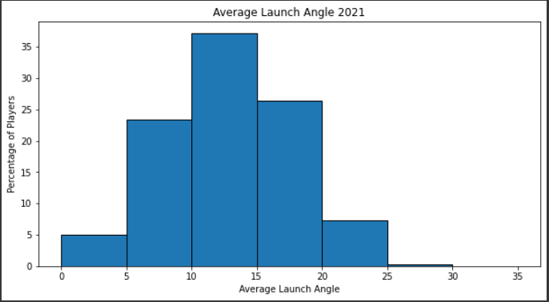
Does a Higher Launch Angle Result in More Power?
“Sweet Spot” is between 25-30 degrees
Notes:
Tommy

Slide 10
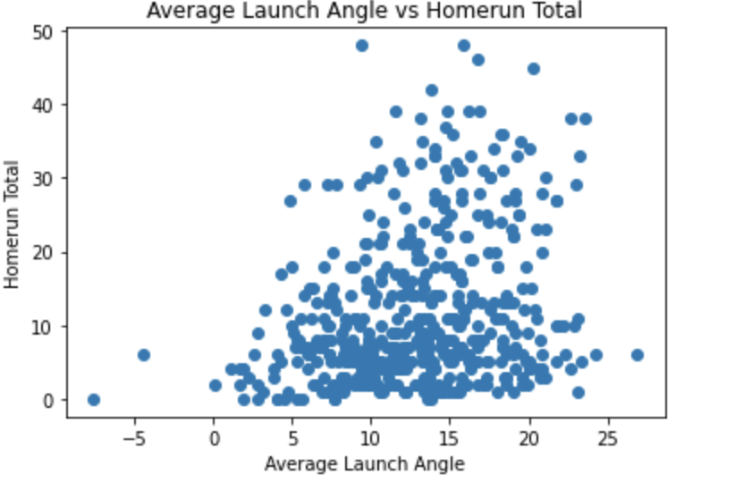
Does a Higher Launch Angle Result in More Power?
Home runs:
Correlation Coefficient
r = 0.268973
Notes:
Tommy

Slide 11
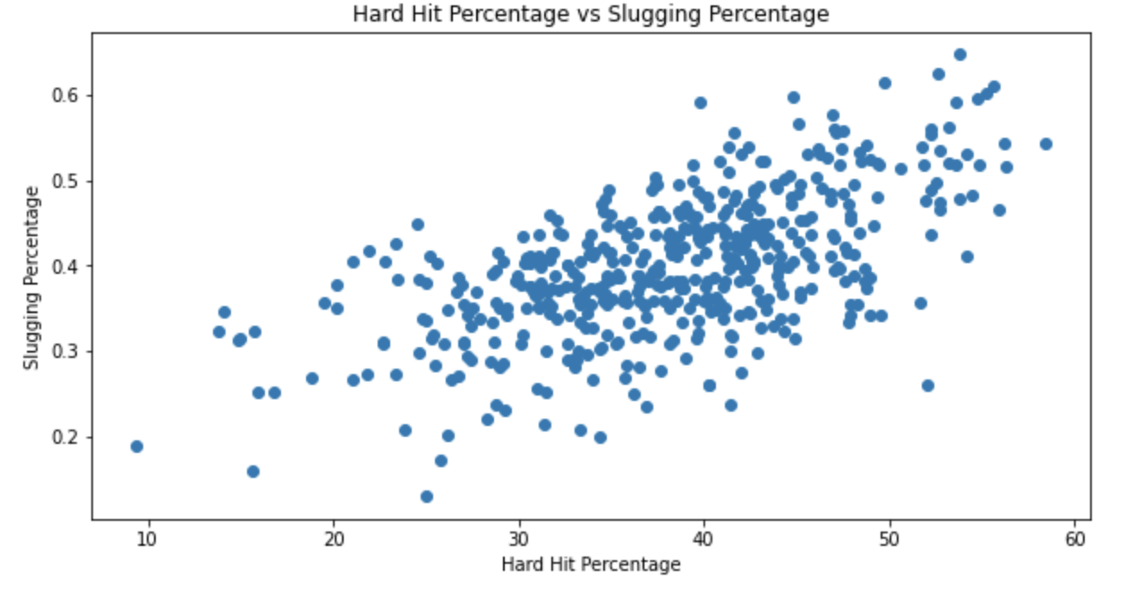
Further Analysis of Power Prediction
Hard Hit Percentage:
Correlation Coefficient
r = 0.603398
Notes:
Ryan

Slide 12
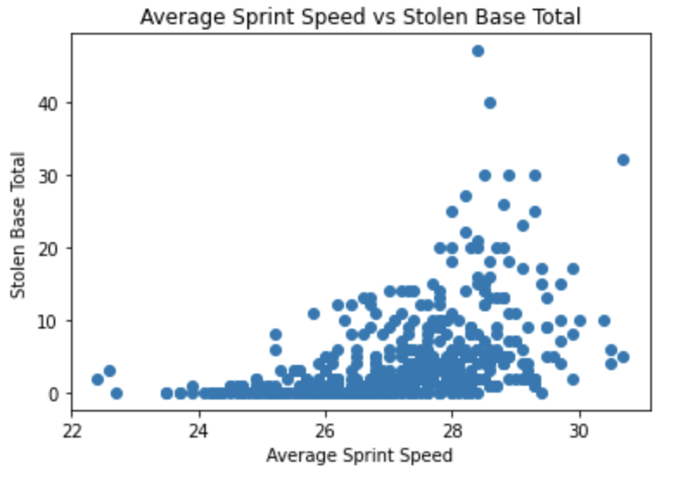
What is the Relationship between Speed and Stolen Bases?
Stolen Base Total:
Correlation Coefficient:
r = 0.459809
Notes:
Ryan

Slide 13
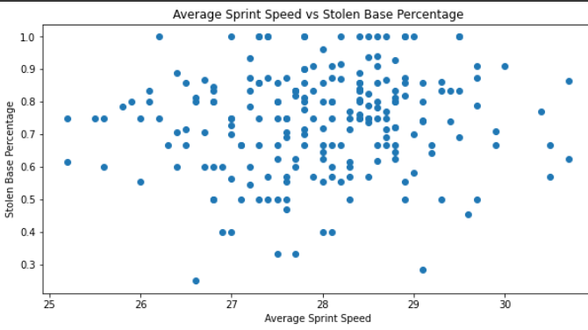
What is the Relationship between Speed and Stolen Bases?
Stolen Base Percentage:
Correlation Coefficient:
r = 0.235185
Notes:
Ryan

Slide 14
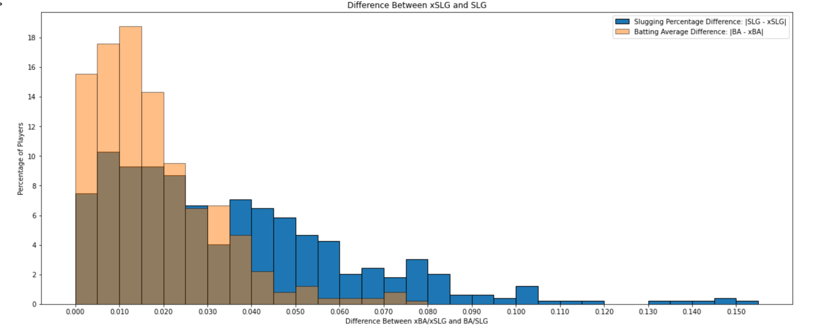
How Do Expected Averages Compare with Actual Averages?
Notes:
Tommy

Slide 15
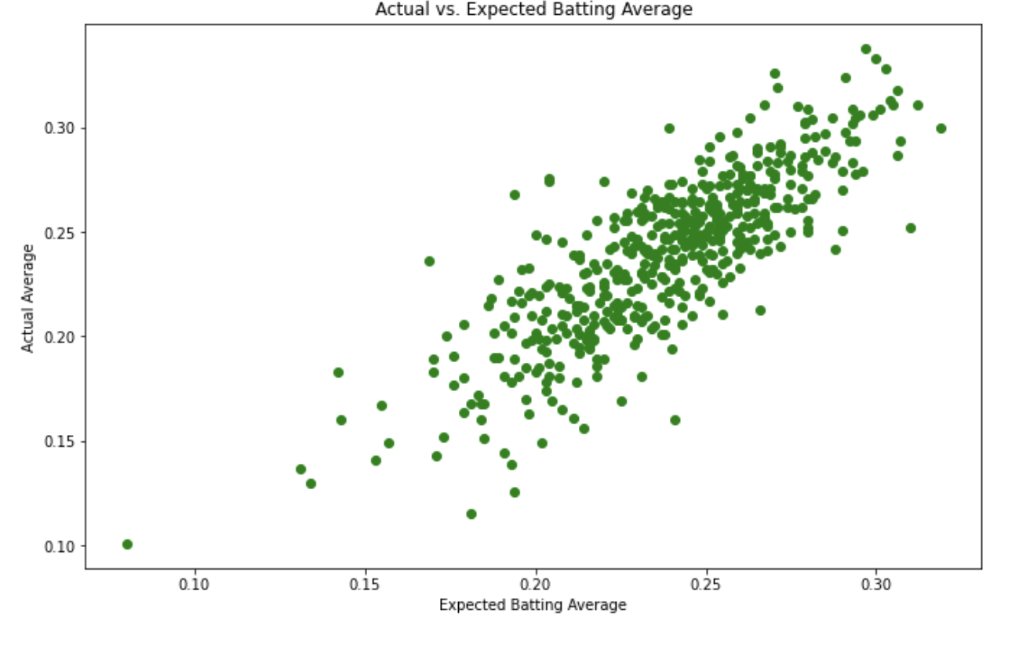
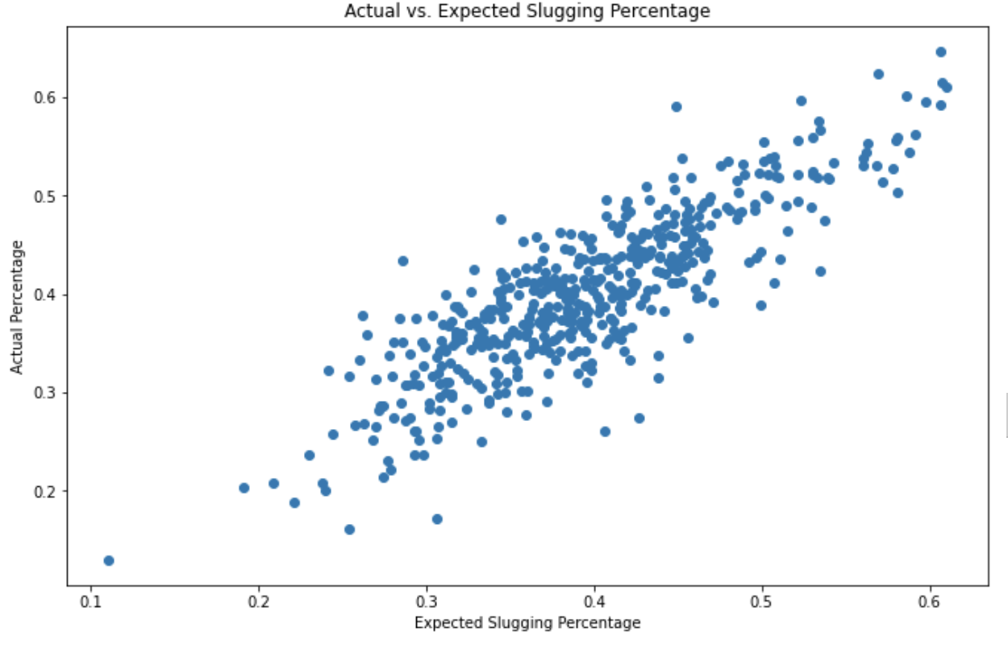
Expected Batting vs Actual Batting continued...
Notes:
Clear correlation
Tommy
About a .8 correlation for both

Slide 16
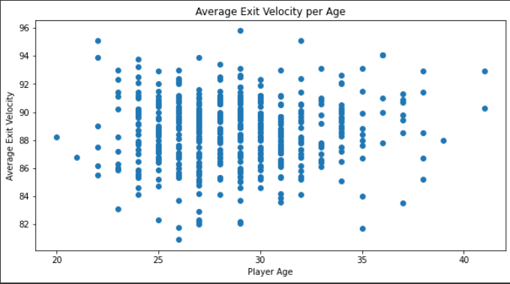
How Does Age Impact Statcast Measures?
Exit Velocity:
Mean of Average Exit Velocity
Age <30: 88.49 mph
Mean of Average Exit Velocity
Age >= 30: 88.58 mph
Notes:
Tommy

Slide 17
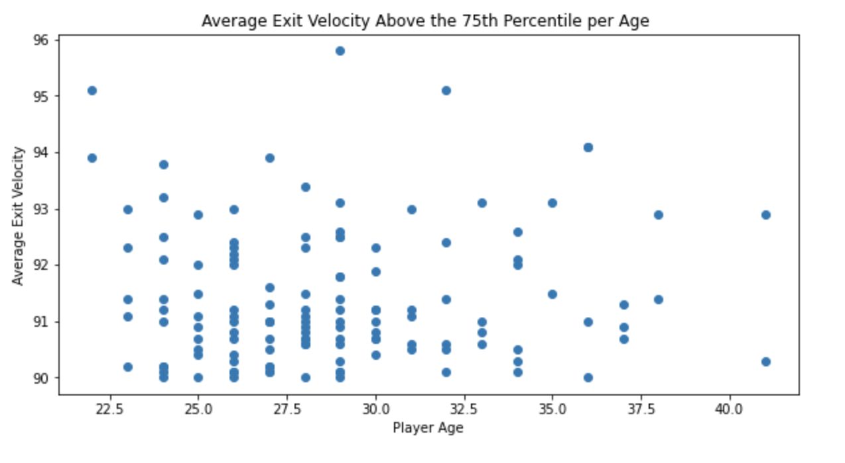
Average EV per Age (75th percentile)
Exit Velocity:
% Age < 30 with EV > 90
27.56%
% Age >= 30 with EV > 90
23.50%
Notes:
Tommy

Slide 18
Conclusions
How accurately do Statcast metrics predict actual performance?
Mixed results
Hard-Hit, xba, xslg predicted well
Launch Angle, Sprint Speed, Exit Velocity not as well
Notes:
Ryan

Slide 19
Future Work
Compare Max Exit Velocity per Age
Pitcher Statistics
Compare OAA to other defensive metrics from other sites
DRS, UZR, etc.
Notes:
Ryan
Expected ERA, spin rate

Slide 20
Lessons and Challenges
Lessons:
Manipulate data in order to form a better story
Be flexible with questions/hypotheses
Challenges:
Google Collaboratory
Not being able to work at same time
Narrowing research
Limiting variables
Notes:
Ryan

Slide 21
Thank you!
Any questions?
Notes:
Ryan

